Slide 1


Project Name :
AUTO MPG REGRESSION ANALYSIS
2
Group Number :
Group Members : Pasula Pavani
Tata Keerthana
Kuntala Vishnupriya
Gone Sharanya
Arkatala Srinidhi
Salveru Manasa

Slide 2
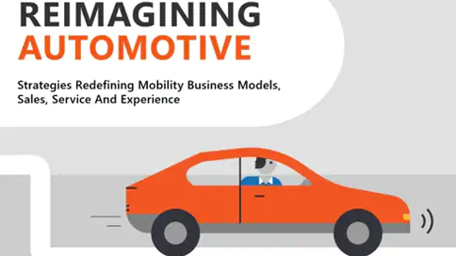
Background :
The automotive industry is extremely competitive. With increasing fuel prices and picky customers, automobile makers are constantly optimizing their process to increase fuel efficiency .

Slide 3


The Path
Objective :
Our objective is to predict the MPG of a car based on the remaining attributes of the dataset.
A data set is considered to predict MPG through the parameters like Displacement, Horsepower, Weight, Cylinders, Acceleration, Origin. For prediction we used one of the machine learning algorithm named LINEAR REGRESSION.
Dataset is downloaded from the link : https://archive.ics.uci.edu/ml/datasets/auto+mpg

Slide 4
Data and Data Quality Check
In this data we have 9 attributes and 398 observations.
Attributes present in the data set are Horsepower, Acceleration, Cylinders, Displacement, Weight, MPG, Car name, Origin, Model year.
Data consists of -------- 1 String (Car name)
5 Continuous variables (MPG, Horsepower, Displacement, Acceleration, Weight)
3 Discrete variables (Cylinders, Origin, Model year)
We found 6 missing values in Horsepower attribute and those missing values are replaced with the mean of the attribute.
Created and added one column to the data set based on the attribute Origin (1 –USA, 2—Europe, 3—Japan)

Slide 5
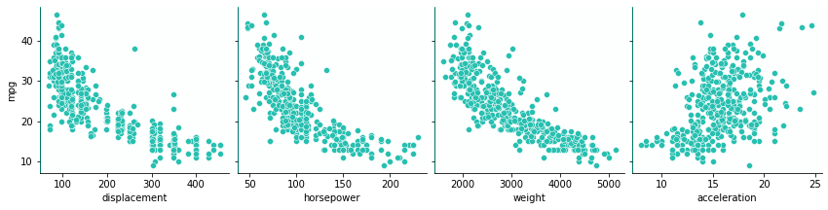
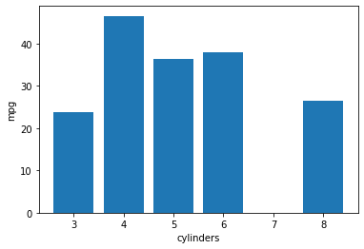
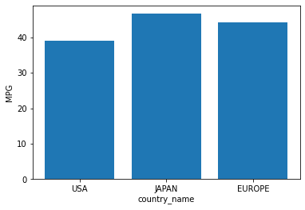
Pair plot of MPG with respect to the remaining attributes

Slide 6
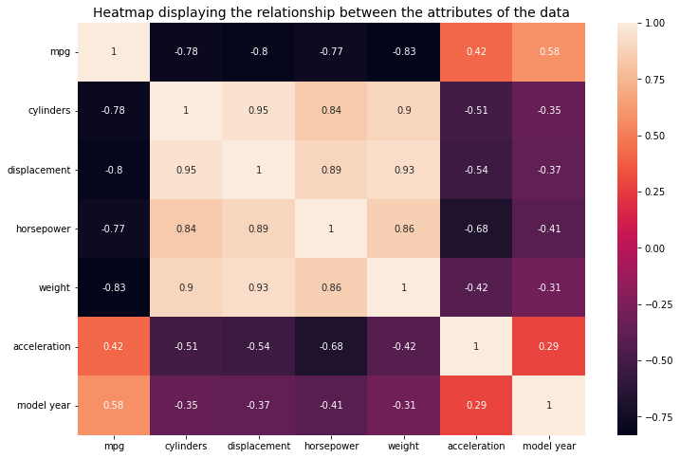
EDA Insights
Correlation check :
-0.83
0.58

Slide 7
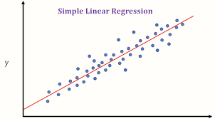
Algorithms :
Depending on the response : Continuous (Linear Regression)
Linear regression is easier to apply and to predict the response variable .
It is the first machine learning algorithm that every data scientist comes across which lays the foundation for other machine learning algorithms.
The main objective of this algorithm is to find a relationship between the independent and dependent variables.

Slide 8
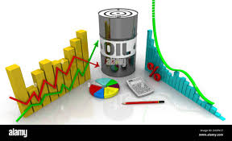
Model Statistics :
Variables | Coefficients
X1 (Cylinders) | -0.25574406
X2 (Displacement) | 0.86526188
X3 (Horsepower) | -0.29663133
X4 (Weight) | -5.68106499
X5 (Acceleration) | 0.44715614
X6 (Model year) | 2.77364436
Train size = 70% and Test size = 30%
Accuracy : 0.8066396544567368
Test score : 0.8066396544567368
Train score : 0.8064770604200187
Mean squared error : 12.356090107920608
Root mean squared error : 3.515123057290984
Intercept : 23.381554983159383

Slide 9
Summary & Recommendations :
The Auto MPG dataset is a collection of 398 automobile records from 1970 to 1982. It contains attributes like car name, horsepower, displacement,...etc.
We were able to find the relationship (either positively correlated or negatively correlated ) between the attributes.
To predict MPG values, Linear Regression is being selected.
We fitted the model with 80% accuracy which is close to the observed values based on the parameters like horsepower, displacement, weight..etc. and studied the results ,outcomes and interpretations .
The basic regression model has given the maximum accuracy .

Slide 10
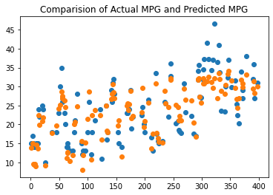
Scattered Diagram of Actual and Predicted MPG Values :
MPG
CAR INDEX

Slide 11

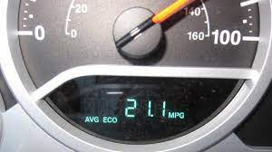
MPG, or Miles Per Gallon, is the distance measured in miles, , that a car can travel per gallon of fuel. MPG is also the primary measurement of a car’s fuel efficiency: The higher a car’s MPG, the more fuel efficient it is.
1 US gallon = 3.785 litres. 1 Mile = 1.609 Kilometres
A car’s MPG can be inconsistent because it is affected by a number of different factors, so it is difficult to get an accurate measurement.
MPG is an important metric to know about any vehicle that you’re considering purchasing.
Add-ons of MPG :

Slide 12
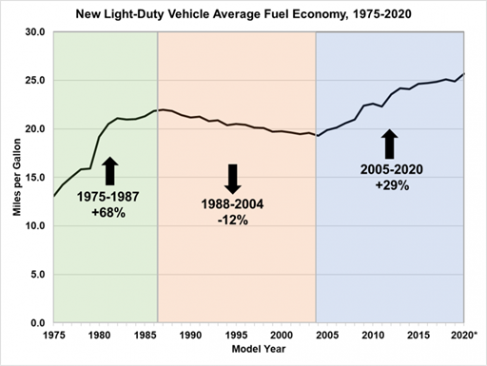


Slide 13
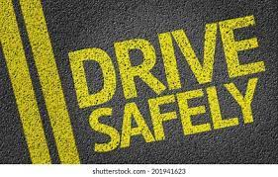
tips For Safe Driving 1.Do not drink and drive. 2.Keep a safe distance from vehicles! 3.Buckle up before you drive. 4.Do not drive on the wrong side. 5.Always wear a helmet! 6.Always give an indicator while changing lanes lanes. 7.Drive within the speed limits. 8.Don't use mobile phones while driving. 9.Always wear seatbelt.

Slide 14

References :
For auto-mpg dataset : https://archive.ics.uci.edu/ml/datasets/auto+mpg
Code link:
P. Pavani : https://github.com/PasulaPavani/auto-mpg-prediction.git
T. Keerthana : https://github.com/Keerthanatata/auto-mpg-.git

Slide 15

THANK YOU UNP TEAM & Aurora’s Degree and PG College

